Slide 1






Planning for Solar at the Convergence of Resilience and Energy (SCORE)
Implications of community engagement for prioritizing resilience investments
Susan Clark,¹ Jan Whittington,²
Siman Ning,² Haoyu Yue,²
Andrea Harder,¹Leah Bargnesi,¹ Hillary Bialecki,¹ Chin-Wei Chen²
¹ Department of Environment and Sustainability, University at Buffalo
² Department of Urban Design and Planning, University of Washington
Notes:
Good afternoon.
My name is Susan Clark, and I’m an Associate Professor at UB.
Today, I’ll be giving you a brief summary of a collaborative project entitled….
Although this project had many components, I’ll be F]focusing on the community engagement aspects of this project for prioritizing resilience investments.
Here I highlight the team of researchers focused on the community engagement that span both the UB and UW.
The overall project is funded by DOE through NREL, with other collaborators including EPRI and Seattle’s municipal electric utility, Seatle city light.

Slide 2
SCORE Project objectives:
help utilities make informed resilience investments by minimizing the consequences of power outages for households
develop and apply a resilience metric (i.e., critical service access metric) focused on the consequences of power outages for households in the Duwamish Valley of Seattle, WA
identify critical infrastructure that might be particularly important to the community during outages
highlight the insights gained from community engagement for the prioritization of resilience investments
Notes:
The heart of this project is really focused on the recognition that existing energy system resilience metrics focus on the performance of physical infrastructure but do a poor job of considering the relationship between the infrastructure and people that rely on it.
In other words we don’t have metrics that allow is to really get at the consequences of otuages on households, which is becoming increasingly more important as extreme weather and electrification demands are putting higher demands on our infrastructure systems, aking them more prone to outages.
The SCORE project is meant to address these gaps…
Overarching goal (first bullet)
Second bullet – builds on previous research seeking to quantify the social impacts of power power outages in PR, Texas…
Ultimately, we want to help deploy resilience solutions where they can make the most difference.

Slide 3
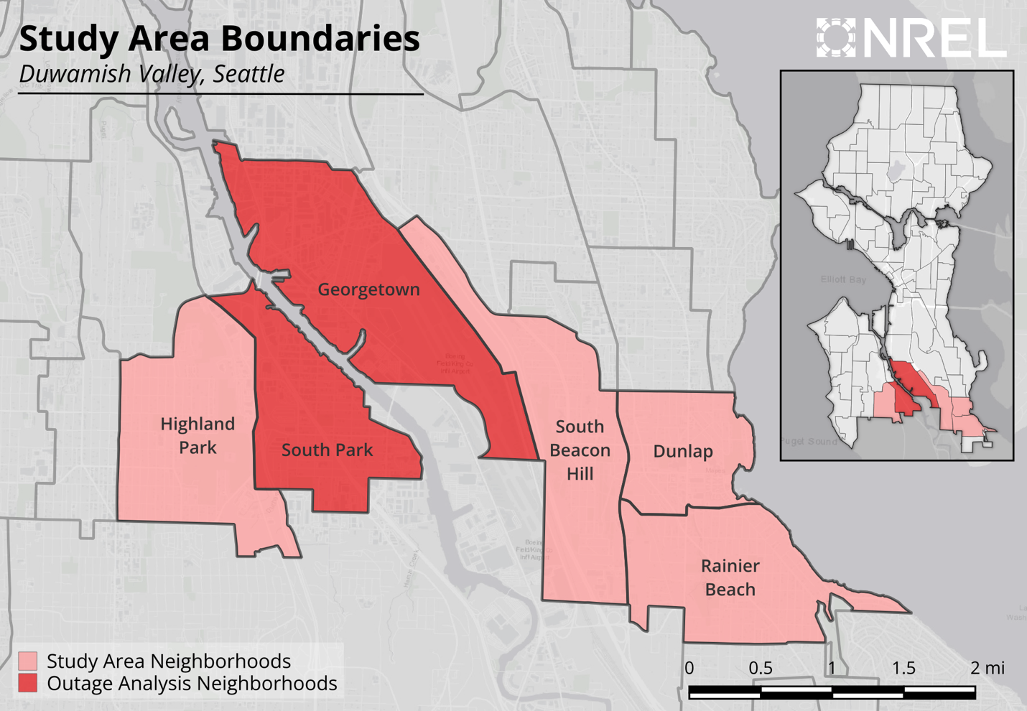
Study Area: Duwamish Valley in Seattle, WA
Notes:
This is a map pf our study region, select neighborhoods in Seattle Washington known at the Duwamish Valley
-named for an indigenous tribe that has resided in this region. These are environmental justice communities, suffering from a history of industrial pollution in the region.

Slide 4

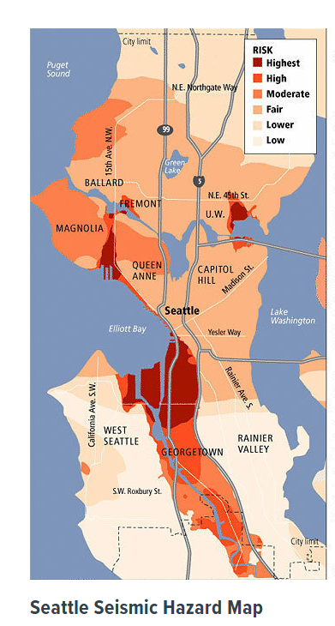
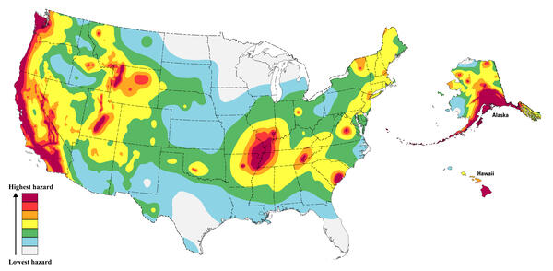
Sources/Usage: Public Domain. View Media Details
Earthquake hazard map showing peak ground accelerations having a 2 percent probability of being exceeded in 50 years, for a firm rock site. The map is based on the USGS models for the conterminous U.S. (2023), Hawaii (2021), and Alaska (2023). The models are based on seismicity and fault-slip rates and take into account the frequency of earthquakes of various magnitudes. Locally, the hazard may be greater than shown, because site geology may amplify ground motions.

Slide 5
A new consequence-focused resilience metric: Critical Service Access
Based on the concept of service accessibility: the relative availability of critical services across a neighborhood during a power outage
Assumes that an outage will reduce a household’s ability to access electricity-dependent services typically accessed at home, but power at service locations near the household will mitigate its loss of critical service access
Objective: identify key service providing locations for resilience investments
Notes:
So a little bit more on the critical service access metric we have been developing and testing…
It is based on the concept of service accessibility – or the availability of critical service access across a neighborhood. In other words access to things like food, water, healthcare, etc.
A key assumption for this metric is that during a power outage, a household’s ability to access critical services depends heavily on if service providing locations like grocery stores and gas stations near them have power and are able to maintain services to the community.
And by making sure key service providing locations remain open we can mitigate the consequences of outages to households.

Slide 6
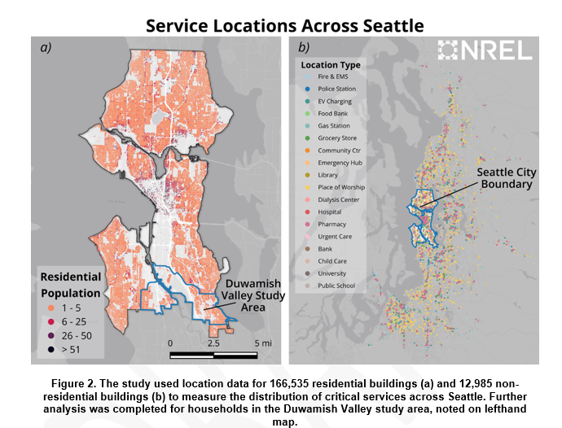
Which critical service locations should be prioritized?
Critical Service Access Metric:
uses publicly available data to identify locations providing critical services to households
scores are assigned reflecting quality of service provided by each location type (next slide)
A gravity model computes travel times between households and critical service locations
Aggregating the value of a location to each household (within 60-minute drive) gives the total baseline value of that location for the neighborhood
Notes:
The question then becomes, which location should be prioritized for resilience investments, knowing that we don’t have the resources to have back up power for all locations.
Here is how the metric is calculated….
First we identify locations providing critical services to households across the area, like community centers, hospitals, etc.. Here I show a map of these locations in Seattle. What locations are determined are based primarily on FEMA and DHS designations of critical infrastructure.
Then a service quality matrix is used to score each location in terms os how well each location meets different types of critical needs, for instance a grocery store would rank high for meeting foods needs, whereas a doctor office would not, but it would have a high service value for medical care.
Then a gravity model is used to compute travel times between each household and critical facility for different travel modes.
Then you can essentially aggregate the service scores and travel times to come up with a critical service access value for each location, the locations with the highest scores are recommended as a high priority for resilience investments…
SO this we thinik is a really useful tool BUT it lacks any say by the community in terms of what they deem as critical and most important to them and their community.
Critical service providing locations with the highest values for each category could be arguably prioritized for back up system and reliability grid enhancements to maintain the provision of key services during an outage.

Slide 7
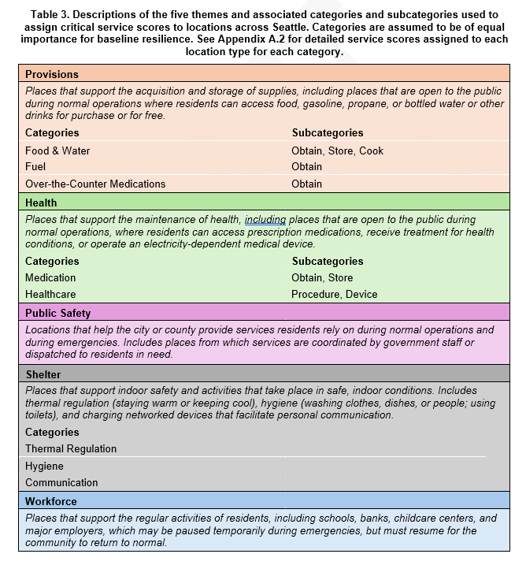
A little more about the metric….
Critical service locations assigned to one of 5 themes
Notes:
How scores are assigned….

Slide 8
But what do the residents of Duwamish Valley think?

Slide 9
Community Engagement Objectives:
Conduct a digital survey and focus groups with Duwamish Valley households to gather information about their needs, preferences, and sensitivities in the event of a power outage.
Identify opportunities to capture community preferences for resilience investments
Refine the critical service access metric with community input
Highlight community-driven insights for strategic resilience planning by Seattle City Light
Notes:
That’s where we came in to engage with Duwamish Valley residents to find out.
SO our specific community engagement efforts were to:

Slide 10
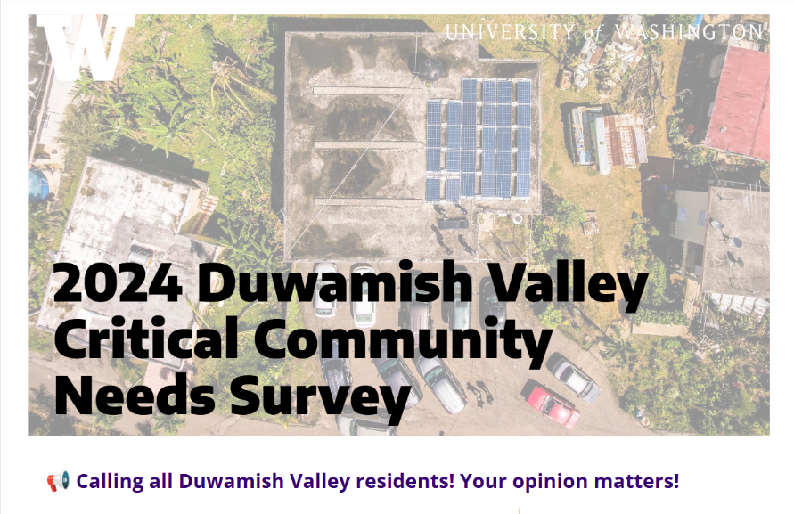
Community Engagement Methodology
Digital household survey co-developed with project stakeholders
Administered from June to October 2024
$20 gift card for completing
Translated into Chinese, Spanish, Vietnamese, Korean, Khmer, Tagalog
IRB approved at both UW & UB
Recruitment materials distributed to 30 local organizations – convenience sampling strategy
Survey respondents invited to participate in focus groups for additional compensation
Notes:
And here is how we did it.
We co-developed a digital survey with project stakeholders, including community representaitves…

Slide 11
Locations utilized during hypothetical power outage (Black-sky):
Locations utilized in typical circumstances (Blue-sky):
Participants indicated how frequently they utilized service providing facilities/locations in their neighborhood
- (i.e., never, a few times a year, monthly, weekly, daily)
Follow up questions were asked about the specific location(s) they visit only the facilities participants indicated they utilized
Location types were categorized as high frequency vs low frequency
Participants indicated which location types they would most likely visit to access critical services
Key assumptions:
Only power disrupted
No evacuation necessary
Outage would last at least a few days
Notes:
The survey was divided into two major parts, the first asked participants about how frequently they utilized a portfolio of service providing locations in their neighborhood in typical blue sky circumstances.
And then they were asked about the specific locations of only the places they aid they utilized
Aas a result of this part of the survey, we were able to categorize the location types that residents utilized as either high frequency, used daily or weekly by many residents vs locations used much more rarely, but could be high impact, like doctors offices, dyalis centers etc….
The second part of the survey asked participants to indicate the location types they were most likely to visit during a hypothetical power outage…this was needed in the survey because Seattle has not experienced a significant outage in recent years. Some key assumptions we included in the hypothetical scenario were…

Slide 12
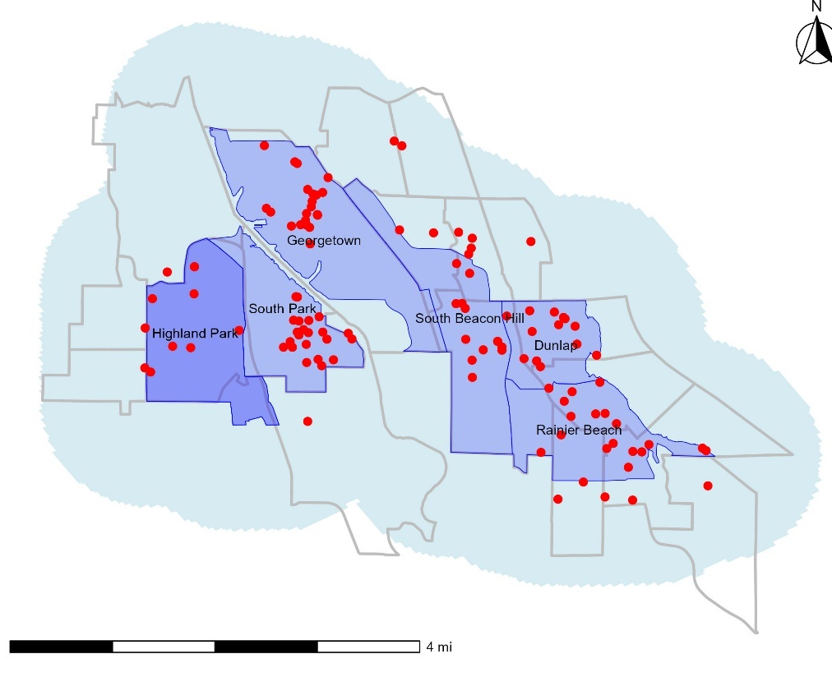
Results: Survey Sample (n=117)
***Households in survey sample are larger, more educated, earn lower incomes, and are more likely to have children at home than the average household in study area Census tracts***
Notes:
And here is our survey sample.
Had over 500 total responses, but only 117 completed within the study region, using a 1 mile buffer, shown with the light blue shading.

Slide 13
Results: Demographic comparison between Census data for the study area and survey sample.
Variable | Seattle Study Area Population (across 6 neighborhoods, n = 33,054) |  | SCORE Survey sample (n=117)
Median Household Income | $89,130 |  | $68,334
Home Ownership | 64% |  | 62%
Race and Ethnicity | 13% Hispanic or Latino |  | 12% Hispanic or Latino
Disability | 12% (disability defined as an individual with a hearing, visual, cognitive, ambulatory, self-care, or independent living disability) |  | 25% (disability defined as (‘condition worsened by a power outage’)
Transportation | 9% do not own a vehicle |  | 7% of households do not own or have access to a vehicle
Age | Median Age | 39 | 42
 | Households with individuals under 18 | 30% | 58%
 | Households with individuals over 65 | 28% | 23%
Household Size | 1 Person | 28% | 15%
 | 2 Person | 31% | 30%
 | 3 Person | 17% | 21%
 | 4 Person or more | 24% | 35%
***Households in survey sample are larger, more educated, earn lower incomes, and are more likely to have children at home than the average household in study area Census tracts.
Notes:
Households in the SCORE survey sample are larger, more educated, earn lower incomes, and are more likely to have children at home than the average household in study area Census tracts.

Slide 14
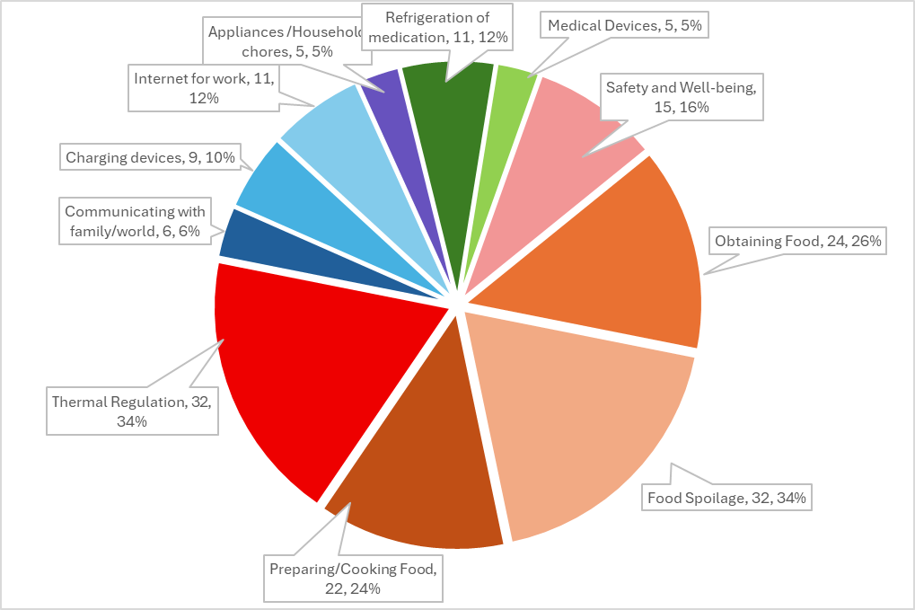
Results: Concerns During Power Outages
Categorized responses to the question “In less than two sentences, please describe what you would be most worried or concerned about during a long-term power outage in your home and why.”
Over 80% of households mentioned some food related concern
Thermal regulation (heating/cooling) was a major concern for 34% of households
Communication/internet/phone charging was a concern for 28% of households
Although medical concerns were rare, they are likely highly impactful to those households
n = 93 responses with 178 total concerns
Notes:
So what did we find…
Here I included a pie chart showing the responses to the question….
We found that…
Food (orange & brown)

Slide 15
Results: Critical Service Locations – Blue Sky
**Note that participants could select more than one specific location***
Category | Top 3 Locations | Responses for Location | Respondents in Category Visiting Daily or Weekly
Gas Station | Costco (4401 4th Ave S) (also grocery store, pharmacy) | 36 | N = 76
 | Safeway (9262 Rainier Ave S) (also grocery store, pharmacy) | 27
 | Shree's Truck Stop Seattle (7801 Detroit Ave SW) | 15
Grocery Store | Safeway (9262 Rainier Ave S) (also gas station, pharmacy) | 36 | N = 97
 | Costco (4401 4th Ave S) (also gas station, pharmacy) | 33
 | Safeway (3900 S Othello St) | 21
Category | Top 3 Locations | Responses for Location | Respondents in Category Visiting Daily or Weekly
Food Bank | Rainier Valley Food Bank (9021 Rainier Ave S) | 13 | N = 24
 | St. Vincent De Paul Georgetown Food Bank (5972 4th Ave S) | 12
 | Lifelong Chicken Soup Brigade Food Bank (210 South Lucile St) | 9
Pharmacy | Safeway (9262 Rainier Ave S) (also gas station, grocery store) | 18 | N = 21
 | Costco Pharmacy (4401 4th Ave S) (also gas station, grocery store) | 15
 | Kaiser Permenante (5316 Rainier Ave S) | 9
High frequency categories (important to many people)
gas station, grocery store, community center, convenience store, library, school, & place of worship
Low frequency categories (highly impactful)
dialysis center, doctor, food bank, pharmacy
Notes:
Here I am showing some of the results for the first part of the survey where we asked about how often participants visited service location in their neighborhood.
The top three locations for gas stations and grocery stores are shown on the left, both categorized as high frequency locations since many respondents indicated utilizing these daily or weekly.
On the right are the top three locations mentioned for food back and pharmacies, both considered low frequency but high impact locations for the community.
The green highlighted cells indicate the locations that overlap, in other words this particular safeway and Costco was a top response across the categories of gas station, grocery store, and pharmacy indicating its importance to the community for providing multiple critical needs.

Slide 16
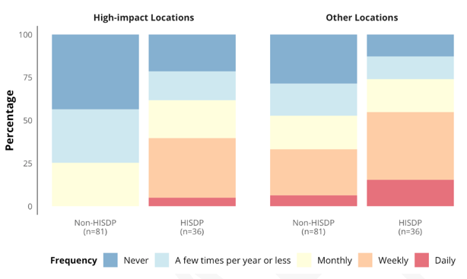
Vulnerability to Power Outages- based upon service dependency
*HISDP = High-Impact Service Dependent Population (n=36)
When compared with Non-HISDP:
HISDP households are more likely to be larger and have children under the age of 5.
Households that frequently visit food banks are more likely to be low income, renters, reliant on public transportation, and non-white.
All households that frequently visit dialysis centers have a member who identifies as non-white.
Aggregated frequency of visits to high impact and all other locations by HISDP and Non-HISDP respondents.
Notes:
Another major finding from the blue sky data was a new way to think about who is most vulnerable to power outages based on their critical service dependency.
For us this is really useful because it allows us to define vulnerability more closely to critical infrastructure use, not just demographic or census data…it helps us understand causal mechanisms between certain populations and why they might be more vulnerable in terms of their access to critical services.
We were able to isolate 36 households in or sample that utilize the low frequency high impact locations on a daily or weekly basis. We call this our high impact service dependent population. And we compared the frequency of visitation to both high impact locations and other locations by that population with the rest of the sample.
What we find is that these particular households not only depend on the low frequency locations more, they depend upon all critical service providing locations more!
And again this is important because it explains at least a prt of the reason why these household types are more vulnerable to outages and gives us information about what me might be able to do about it.

Slide 17
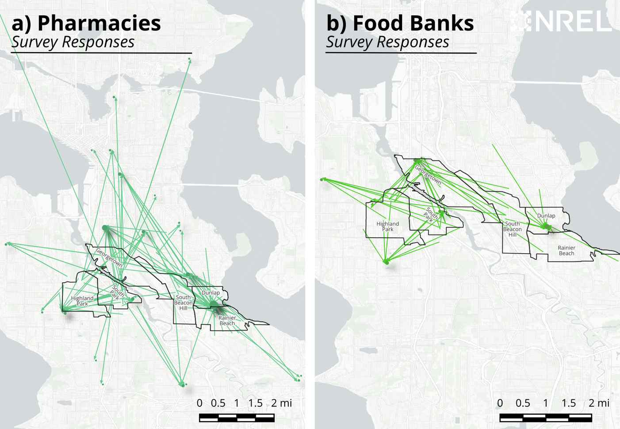
How important is proximity? It depends….
Location Type | % Selecting Closest Facility by Travel Time
Library | 78%
Community Center | 73%
Food bank | 48%
Grocery Store | 45%
Dialysis Center | 33%
Public School | 29%
Pharmacy | 17%
Percent of responses that selected the location closest to them in each category.
Spatial relationship between respondents and pharmacies (left), and respondents and food banks (right).
Notes:
Now a key assumption in the critical service access metric is that proximity is really important, remember, it uses travel times to compute the value of service locations…
But our work makes clear that although proximity seems to be important, it seems to be more important for some location types than others.
For instance, survey data suggests that for libraries and community centers proximity seems to be a key factor, but for other locations likes pharmacy there are likely other factors at play, like does it take my insurance and does it carry the medication I need…so it’s a good assumption but only for some location types.

Slide 18
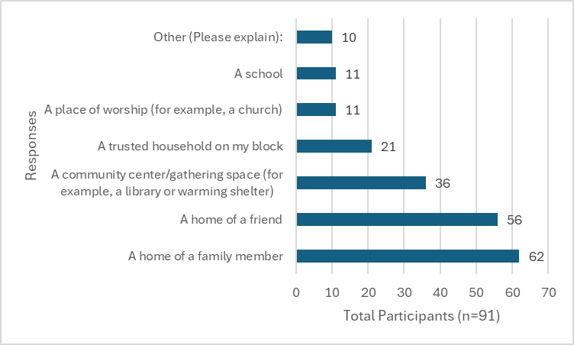
Responses to the question “Please select all locations where you might consider relocating for the duration of the outage.”
Critical Service Locations – Black Sky
Frequency of selections by respondents of locations preferred to meet needs during hypothetical power outage.
Location Types | Cook Food | Obtain Food/Water | Store Food | Store Medicine | Healthcare Procedure | Operate Medical Device | Thermal Regulation | Hygiene | Communication | Information | Lighting | Other Tasks | Total
Community Center | 3 | 1 | 0 | 0 | 0 | 0 | 13 | 1 | 25 | 39 | 13 | 4 | 99
Grocery store | 1 | 37 | 8 | 1 | 1 | 1 | 4 | 0 | 0 | 0 | 4 | 0 | 57
Gas station | 1 | 0 | 0 | 0 | 0 | 0 | 0 | 0 | 0 | 1 | 0 | 0 | 2
Home of a friend or family member | 24 | 6 | 19 | 4 | 0 | 1 | 34 | 19 | 30 | 17 | 14 | 4 | 172
Pharmacy | 0 | 1 | 1 | 3 | 21 | 2 | 0 | 1 | 0 | 0 | 0 | 0 | 29
Notes:
The last major finding I wanted to share with you stems from the survey data about the black sky hypothetical outage data.
On the left is a table showing some of the results, in terms of the number of responses for each location type in terms of meeting particulat needs…
The clear winner for many needs and across needs is home of a friend or family member, not a public service providing location. It even beat out community centers, which are currently th priority for resilience investments in that area.
When we asked about where people would prefer to relocate duing a prolonged outage if need be, a home of a friend or family member got the most responses.
This is really important for revising the metric, in fact we are working on having the critical service access metric treat residential locations as important service providing locations for particular needs and exploring the implications of this finding.

Slide 19
Key Implications of community engagement for resilience investments
Losing/replacing spoiled food is by far biggest concern for most households.
Participants indicate visiting a high number of community centers, grocery stores, and gas stations daily or weekly to meet their basic needs during normal Blue-sky conditions.
We can redefine social vulnerability to power outages based on populations with critical service dependency
Residential locations are important for meeting specific types of needs
Notes:
And ultimately, all of these findings and more are helping us to make more strategic decisions about how to allocate resources effectively for mitigating the consequences of power outages on households

Slide 20
Other current studies & future work
Wildfire in the west
PUSH Buffalo
National survey

Slide 21
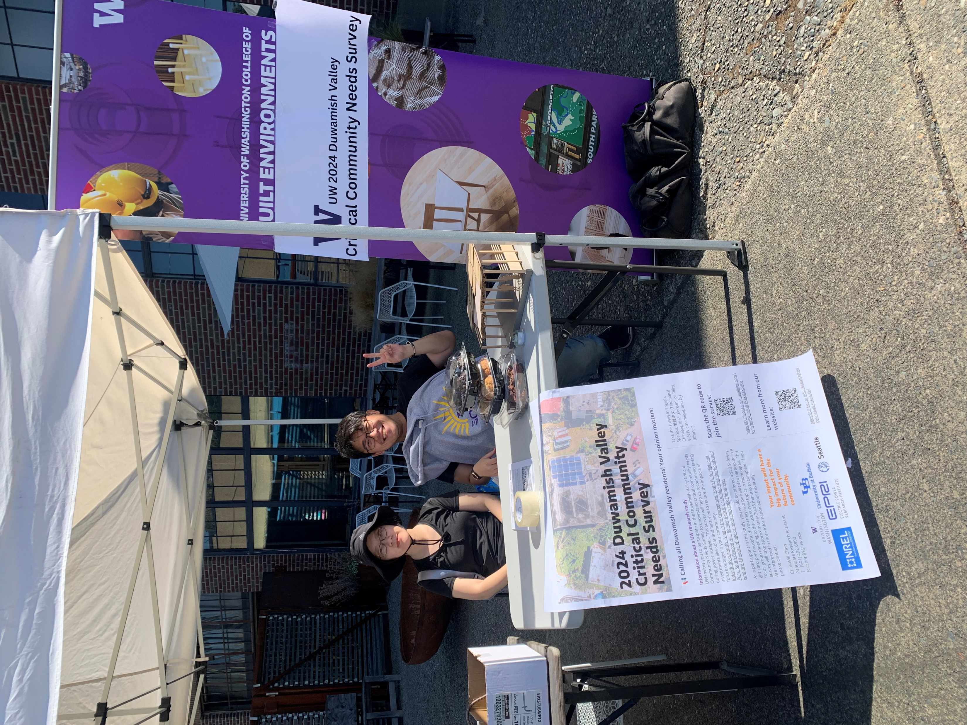
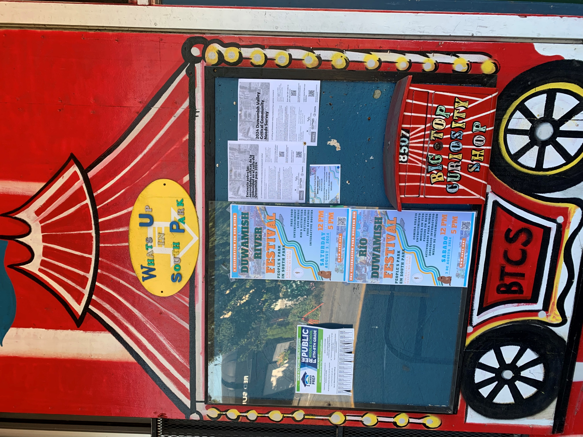
Thank you!
Susan Spierre Clark
Associate Professor
Department of Environment & Sustainability
University at Buffalo
sclark1@buffalo.edu
Project website:
https://uil.be.uw.edu/research/critical-needs-research/

Slide 22
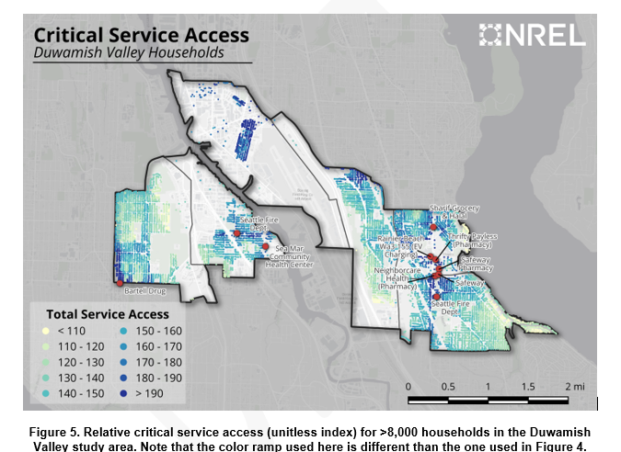
Notes:
We use public data, primarily public data from national sources, to identify locations providing critical services to households across Seattle (see Appendix A.1 for data sources). Locations providing critical services include residential buildings, which are assumed to provide services only to people living onsite, and non-residential buildings in 23 categories, which are assumed to provide services to households within a 60-minute drive radius (Figure 2).
Critical service access is a unitless metric that provides insight into the spatial distribution of critical services and the relative amount of critical service access among households across a study area. Households in the Duwamish Valley study area have relatively low access to critical services compared with other households across Seattle (Figure 4); there is, however, notable variation in levels of critical service access within the six neighborhoods of the study area (Figure 5). Access to critical services in the study area is supported by non-residential service locations like two fire stations, a community center, an EV charging station, a large and small grocery store, and several pharmacies. The distribution of households across both sides of the Duwamish River, an interstate highway, and an airport creates clusters of relatively high access on either side of this north-south infrastructure.

Slide 23
Notes:
A scoring matrix assigns a value reflecting the relative quality of service provided by each location type across five categories of electricity-dependent critical services: provisions, health, public safety, shelter, and workforce (Figure 3). These categories, and their corresponding subcategories, were developed using U.S. Federal Emergency Management Agency (FEMA) Community Lifeline guidance, the U.S. Department of Homeland Security (DHS) critical infrastructure sectors, human capabilities research, and community engagement conducted as part of this project and others in the Department of Energy Renewables Advancing Community Energy Resilience (RACER) portfolio [6], [7], [8], [9], [10], [11]. The assignment of critical service scores depends on information about service location types included in public datasets.
For example, hospital location data from the U.S. Department of Homeland Security include information about the level of trauma care available at each location. Hospitals providing “Level 1” trauma care are assigned a higher score in the “Health — Healthcare Procedures” category than other types of hospitals.
Grocery store location data from the U.S. Department of Agriculture (USDA) include information about the size of each store. “Small” grocery stores are assigned a lower score in the “Provisions — Food & Water” category, while “Large” grocery stores are assigned a higher score in this category. “Small” and “Large” are designated in the USDA grocery store data, but not defined, and we interpret these subcategories as relating to the capacity of each store.

Slide 24
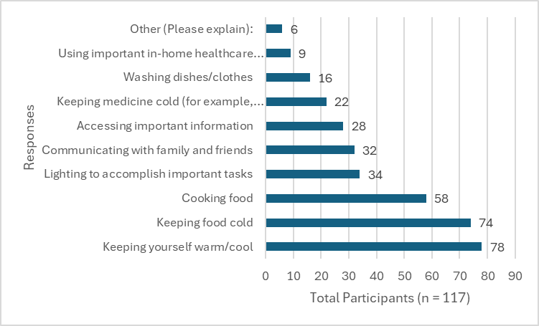
Responses tallied for the question “Imagine the following activities were disrupted by the outage. Please indicate which disrupted activities would have a significant impact on the health and well-being of your household. Select all that apply.”
Notes:
These open-response concerns are echoed in respondents’ ranking of pre-identified activities that are most likely to cause significant impacts if disrupted (Figure 26). Out of 117 responses, cooking food (n = 58), keeping food cold (n = 74), and thermal regulation (n = 78) are the activities most frequently selected as having high impacts on health and well-being if disrupted. These activities are selected much more frequently than other options provided, including keeping medicine cold, washing dishes or clothes, and using important in-home healthcare devices. Most respondents report having less than seven days of shelf-stable food (67%) and bottled drinking water (72%) available at home, potentially driving or exacerbating concerns about food access during outages. These results suggest that maintaining access to safely stored food and water, internet, and safe temperatures during power disruptions, especially those lasting multiple days, could be key priorities for energy resilience projects in the study area.

Slide 25
Results: Demographic comparison between Census data for the study area and survey sample.
Variable | Seattle Study Area Population (across 6 neighborhoods, n = 33,054) |  | SCORE Survey sample (n=117)
Median Household Income | $89,130 |  | $68,334
Home Ownership | 64% |  | 62%
Race and Ethnicity | 13% Hispanic or Latino |  | 12% Hispanic or Latino
Disability | 12% (disability defined as an individual with a hearing, visual, cognitive, ambulatory, self-care, or independent living disability) |  | 25% (disability defined as (‘condition worsened by a power outage’)
Transportation | 9% do not own a vehicle |  | 7% of households do not own or have access to a vehicle
Age | Median Age | 39 | 42
 | Households with individuals under 18 | 30% | 58%
 | Households with individuals over 65 | 28% | 23%
Household Size | 1 Person | 28% | 15%
 | 2 Person | 31% | 30%
 | 3 Person | 17% | 21%
 | 4 Person or more | 24% | 35%
***Households in survey sample are larger, more educated, earn lower incomes, and are more likely to have children at home than the average household in study area Census tracts.
Notes:
Households in the SCORE survey sample are larger, more educated, earn lower incomes, and are more likely to have children at home than the average household in study area Census tracts.

Slide 26
Critical Service Locations – Black Sky
Location Types | Cook Food | Obtain Food/Water | Store Food | Store Medicine | Healthcare Procedure | Operate Medical Device | Thermal Regulation | Hygiene | Communication | Information | Lighting | Other Tasks | Total
Bank | 0 | 0 | 0 | 0 | 0 | 0 | 1 | 0 | 0 | 1 | 0 | 0 | 2
Convenience store | 1 | 2 | 2 | 0 | 0 | 0 | 0 | 1 | 0 | 1 | 5 | 0 | 12
Community Center | 3 | 1 | 0 | 0 | 0 | 0 | 13 | 1 | 25 | 39 | 13 | 4 | 99
Doctor's office | 0 | 0 | 0 | 0 | 14 | 0 | 0 | 0 | 0 | 0 | 0 | 0 | 14
Dialysis center | 0 | 0 | 0 | 0 | 1 | 0 | 0 | 0 | 0 | 0 | 0 | 0 | 1
Food bank | 0 | 9 | 3 | 0 | 0 | 0 | 0 | 0 | 0 | 1 | 0 | 1 | 14
Grocery store | 1 | 37 | 8 | 1 | 1 | 1 | 4 | 0 | 0 | 0 | 4 | 0 | 57
Gas station | 1 | 0 | 0 | 0 | 0 | 0 | 0 | 0 | 0 | 1 | 0 | 0 | 2
Hospital | 0 | 1 | 0 | 0 | 11 | 1 | 2 | 0 | 0 | 0 | 0 | 0 | 15
Hardware Store | 1 | 0 | 0 | 0 | 0 | 0 | 0 | 0 | 0 | 0 | 1 | 0 | 2
Home of a friend or family member | 24 | 6 | 19 | 4 | 0 | 1 | 34 | 19 | 30 | 17 | 14 | 4 | 172
Laundromat | 1 | 0 | 0 | 0 | 0 | 0 | 0 | 6 | 0 | 0 | 0 | 0 | 7
Other (Walk in clinic) | 0 | 0 | 0 | 0 | 1 | 0 | 0 | 0 | 0 | 0 | 0 | 0 | 1
Pharmacy | 0 | 1 | 1 | 3 | 21 | 2 | 0 | 1 | 0 | 0 | 0 | 0 | 29
Place of Worship | 1 | 0 | 0 | 0 | 2 | 0 | 1 | 1 | 2 | 0 | 0 | 0 | 7
Restaurant | 4 | 3 | 1 | 0 | 0 | 0 | 1 | 0 | 1 | 0 | 0 | 0 | 10
School | 0 | 0 | 0 | 1 | 0 | 0 | 0 | 2 | 0 | 1 | 0 | 0 | 4
Trusted household on my block | 3 | 0 | 2 | 1 | 1 | 0 | 1 | 0 | 2 | 2 | 3 | 1 | 16
Location Types | Cooking Food | Store Food & Water | Store Medication | Operate Medical Devices | Thermal Regulation | Hygiene
Grocery Store | X | X | X | X | X
Convenience store | X | X |  |  |  | X
Pharmacies |  | X | X | X |  | X
Hospitals |  |  |  | X | X
Community Center | X |  |  |  | X | X
Food bank |  | X
School |  |  |  |  |  | X
Locations that at least one respondent indicated they would visit during a power outage to meet needs typically met at home or other residential locations.
Frequency of selections by respondents of locations preferred to meet needs during hypothetical power outage. Darker green indicates higher frequency of responses.
Notes:
Survey respondents were asked which location types they would most likely visit to access specific critical services during a hypothetical power outage. The frequency of responses for each location type were tabulated for each critical service category to understand the anticipated dependence on different location types for various services during an extended power disruption (Table ). Critical service categories used in the survey largely match critical service categories used in the critical service access metric (see Section 2, Figure 3). For ease of interpretation for respondents focused on their individual behaviors, “Information” was separated from “Communication”, “Lighting” and “Other Tasks” were added, and “Public Safety” and “Workforce” categories were removed.
Respondents view community centers as valuable resources for thermal comfort (13), lighting (13), communication with family and friends (25), gathering information (39), and other tasks (4). Grocery stores were a common choice for obtaining food (37) and keeping food cool (4). During power outages, respondents predict that they would rely heavily on the homes of family and friends to meet needs often met in private, residential spaces, including hygiene, storing food, cooking food, and heating and cooling. Respondents indicated they are more likely to visit a pharmacy (21) or doctor’s office (14) than a hospital (11) for healthcare access during a long power outage.
Results suggest uncertainty among respondents about publicly accessible locations where they could access services typically accessed at home if their home is without power for an extended time. This uncertainty could be driven by lack of experience with long power outages or by a lack of awareness about where resources will be deployed in emergency conditions. Table 9 lists the types of locations identified by at least one respondent as being able to meet needs typically met at home, or at the home of a friend or family member. The capacity of these locations to meet these needs during long power disruptions depends on robust emergency coordination efforts and in some cases may not align with where emergency management organizations plan to deploy services. For example, grocery stores may not be prepared or equipped to store people’s food and medications, allow people to operate medical devices, or allow many people to congregate to stay warm or cool (thermal regulation).
These responses highlight the services that may be most valuable to include at resilience hubs, given the reported reliance on private residential spaces to meet these needs and a lack of clarity about where else they may be met. This presents an opportunity for Seattle City Light to coordinate with the Seattle Office of Emergency management and specific site operators to implement energy resilience projects where services can be easily accessed by community members. The success of these projects would then depend on building social capital and clear communication channels among residents about those services prior to an emergency.

